Slide 1
Baum Welch Algorithm

Slide 2
Learning problem
Learning problem. Given some training observation sequences O=o₁ o₂ ... o_{K} and general structure of HMM (numbers of hidden and visible states), determine HMM parameters M=(A, B, π) that best fit training data, that is maximizes P(O | M) .
There is no algorithm producing optimal parameter values.
Use iterative expectation-maximization algorithm to find local maximum of P(O | M) - Baum-Welch algorithm.

Slide 3
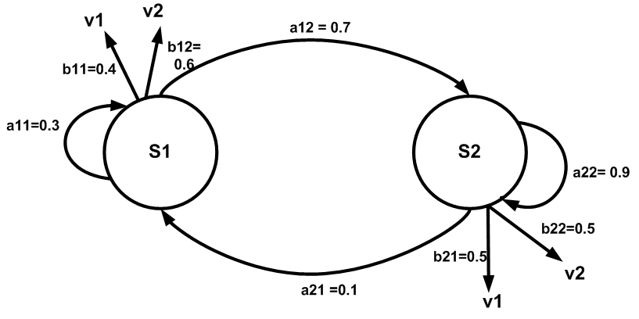
Example of the Baum-Welch Algorithm
We start with a very simple example. Where the number of states is 2 and the output sequence is also 2. We take the set Y of unanalyzed sequences to be {v1v2v2v1}.
State transition diagram of the problem is shown below:

Slide 4
Transition Table
Observation table
 | S1 | s2
s1 | 0.3 | 0.7
s2 | 0.1 | 0.9
 | v1 | v2
s1 | 0.4 | 0.6
s2 | 0.5 | 0.5
Starting probability of s1 is p(s1) = .85 and starting probability of s2 is p(s2) = .15

Slide 5
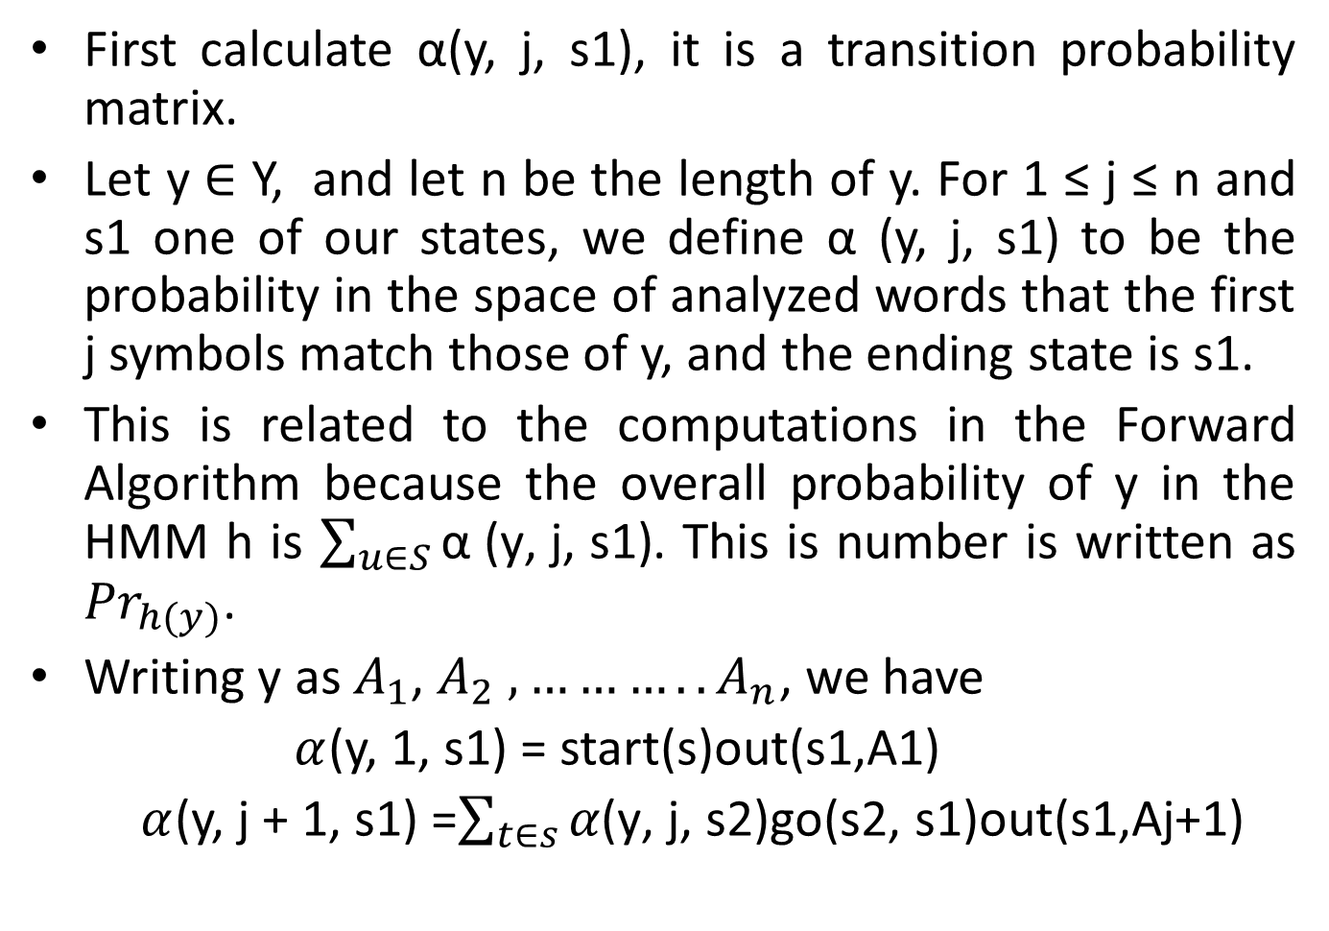
First calculate α(y, j, s1), it is a transition probability matrix.
Let y $∈$ Y, and let n be the length of y. For 1 ≤ j ≤ n and s1 one of our states, we define α (y, j, s1) to be the probability in the space of analyzed words that the first j symbols match those of y, and the ending state is s1.
This is related to the computations in the Forward Algorithm because the overall probability of y in the HMM h is $\sum_{u∈S}{\text{α}\text{ (}\text{y}\text{, }\text{j}\text{, }\text{s}\text{1}\text{)}}$. This is number is written as ${Pr}_{h(y)}$.
Writing y as $A_{1}$, $A_{2} ,………..A_{n}$, we have
$α$(y, 1, s1) = start(s)out(s1,A1)
$α$(y, j + 1, s1) =$\sum_{t∈s}{α\text{(}\text{y}\text{, }\text{j}\text{, }\text{s}\text{2)}\text{go}\text{(}\text{s}\text{2, }\text{s}\text{1}\text{)}\text{out}\text{(}\text{s}\text{1}\text{,}\text{Aj}\text{+1)}}$

Slide 6
v1v2v2v1
α(v1v2v2v1, 1, s1) = (.85)(.4) = 0.34.
α(v1v2v2v1, 1, s2) = (.15)(.5) = 0.08.
α(v1v2v2v1, 2, s1) = (0.34)(.3)(.6) + (0.08)(.1)(.6) = 0.06120 + 0.00480 = 0.06600.
α(v1v2v2v1, 2, s2) = (0.34)(.7)(.5) + (0.08)(.9)(.5) = 0.11900 + 0.03600 = 0.15500.
α(v1v2v2v1, 3, s1) = (0.06600)(.3)(.6) + (0.15500)(.1)(.6) = 0.01188 + 0.00930 = 0.02118.
α(v1v2v2v1, 3, s2) = (0.06600)(.7)(.5) + (0.15500)(.9)(.5) = 0.02310 + 0.06975 = 0.09285.
α(v1v2v2v1, 4, s1) = (0.02118)(.3)(.4) + (0.09285)(.1)(.4) = 0.00254 + 0.00371 = 0.00625.
α(v1v2v2v1, 4, s2) = (0.02118)(.7)(.5) + (0.09285)(.9)(.5) = 0.00741 + 0.04178 = 0.04919.
Total probability of v1v2v2v1 is 0.00625 + 0.04919 = 0.05544.

Slide 7
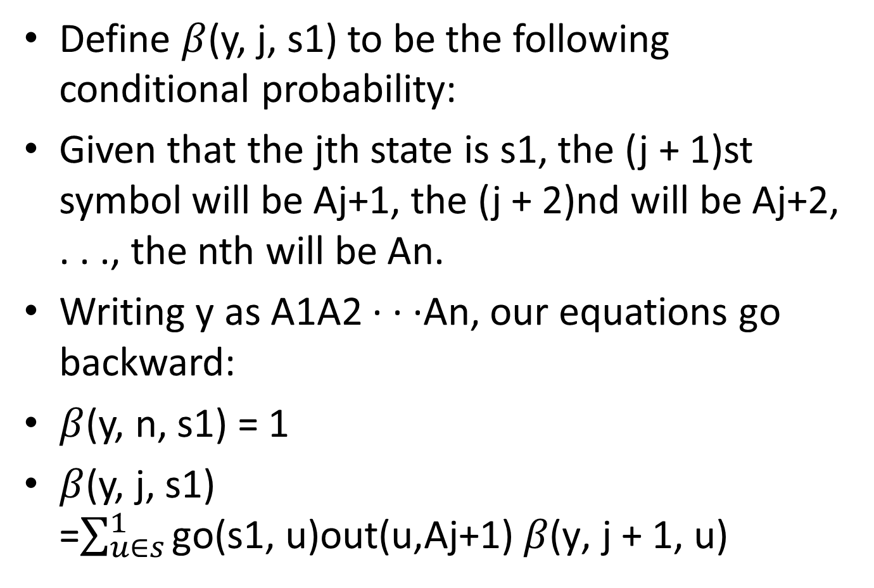
Define $β$(y, j, s1) to be the following conditional probability:
Given that the jth state is s1, the (j + 1)st symbol will be Aj+1, the (j + 2)nd will be Aj+2, . . ., the nth will be An.
Writing y as A1A2 · · ·An, our equations go backward:
$β$(y, n, s1) = 1
$β$(y, j, s1) =$\sum_{u∈s}^{1}{\text{go}\text{(}\text{s}\text{1}\text{, }\text{u}\text{)}\text{out}\text{(}\text{u}\text{,}\text{Aj}\text{+1)} β\text{(}\text{y}\text{, }\text{j}\text{ + 1, }\text{u}\text{)}}$

Slide 8
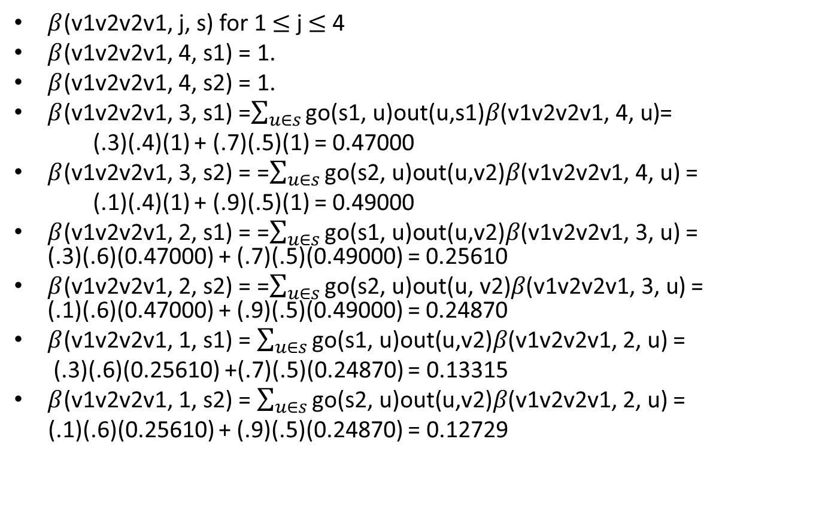
$β$(v1v2v2v1, j, s) for 1 $≤$ j $≤$ 4
$β$(v1v2v2v1, 4, s1) = 1.
$β$(v1v2v2v1, 4, s2) = 1.
$β$(v1v2v2v1, 3, s1) =$\sum_{u∈s}{\text{go}\text{(}\text{s}\text{1}\text{, }\text{u}\text{)}\text{out}\text{(}\text{u}\text{,}\text{s}\text{1}\text{)}β\text{(}\text{v}\text{1}\text{v}\text{2}\text{v}\text{2}\text{v}\text{1}\text{, }\text{4}\text{, }\text{u}\text{)}}$=
(.3)(.4)(1) + (.7)(.5)(1) = 0.47000
$β$(v1v2v2v1, 3, s2) = =$\sum_{u∈s}{\text{go}\text{(}\text{s}\text{2}\text{, }\text{u}\text{)}\text{out}\text{(}\text{u}\text{,}\text{v}\text{2}\text{)}β\text{(}\text{v}\text{1}\text{v}\text{2}\text{v}\text{2}\text{v}\text{1}\text{, 4, }\text{u}\text{)}}$=
(.1)(.4)(1) + (.9)(.5)(1) = 0.49000
$β$(v1v2v2v1, 2, s1) = =$\sum_{u∈s}{\text{go}\text{(}\text{s}\text{1}\text{, }\text{u}\text{)}\text{out}\text{(}\text{u}\text{,}\text{v}\text{2}\text{)}β\text{(}\text{v}\text{1}\text{v}\text{2}\text{v}\text{2}\text{v}\text{1}\text{, }\text{3}\text{, }\text{u}\text{)}}$= (.3)(.6)(0.47000) + (.7)(.5)(0.49000) = 0.25610
$β$(v1v2v2v1, 2, s2) = =$\sum_{u∈s}{\text{go}\text{(}\text{s}\text{2}\text{, }\text{u}\text{)}\text{out}\text{(}\text{u}\text{,} \text{v}\text{2}\text{)}β\text{(}\text{v}\text{1}\text{v}\text{2}\text{v}\text{2}\text{v}\text{1}\text{, }\text{3}\text{, }\text{u}\text{)}}$= (.1)(.6)(0.47000) + (.9)(.5)(0.49000) = 0.24870
$β$(v1v2v2v1, 1, s1) = $\sum_{u∈s}{\text{go}\text{(}\text{s}\text{1}\text{, }\text{u}\text{)}\text{out}\text{(}\text{u}\text{,}\text{v}\text{2}\text{)}β\text{(}\text{v}\text{1}\text{v}\text{2}\text{v}\text{2}\text{v}\text{1}\text{, }\text{2}\text{, }\text{u}\text{)}}$=
(.3)(.6)(0.25610) +(.7)(.5)(0.24870) = 0.13315
$β$(v1v2v2v1, 1, s2) = $\sum_{u∈s}{\text{go}\text{(}\text{s}\text{2}\text{, }\text{u}\text{)}\text{out}\text{(}\text{u}\text{,}\text{v}\text{2}\text{)}β\text{(}\text{v}\text{1}\text{v}\text{2}\text{v}\text{2}\text{v}\text{1}\text{, }\text{2}\text{, }\text{u}\text{)}}$=
(.1)(.6)(0.25610) + (.9)(.5)(0.24870) = 0.12729

Slide 9
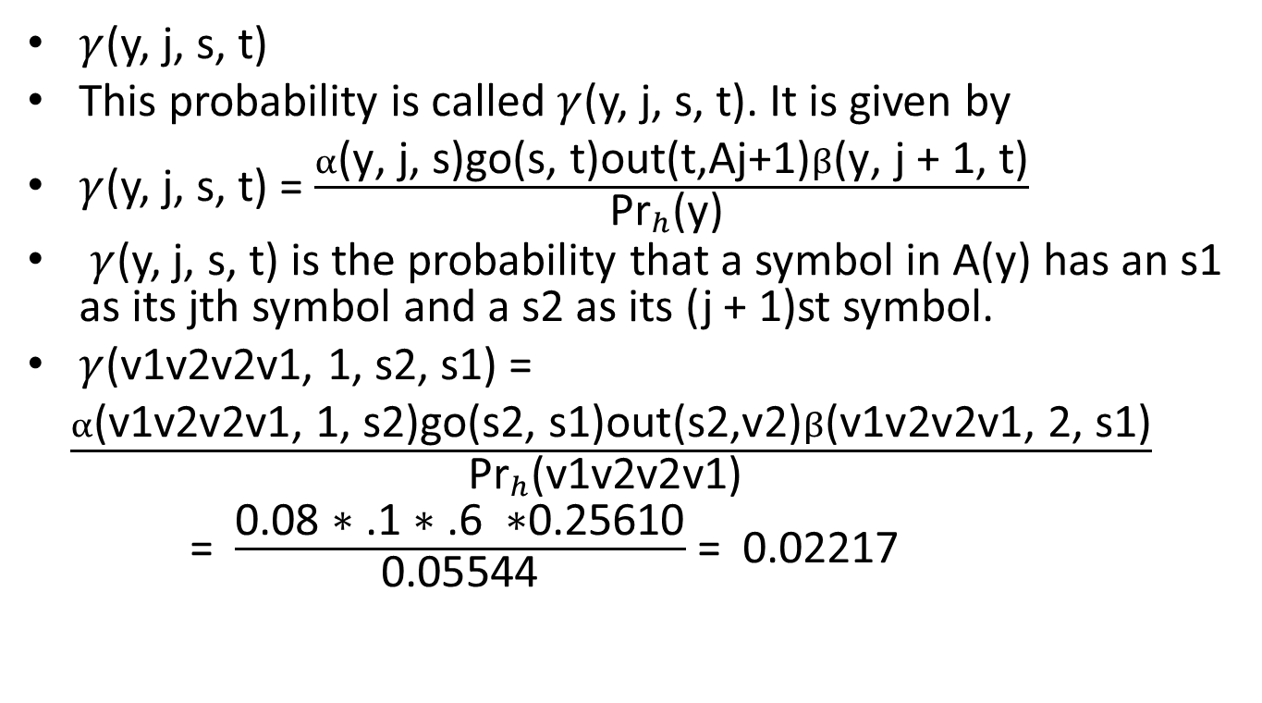
$γ$(y, j, s, t)
This probability is called $γ$(y, j, s, t). It is given by
$γ$(y, j, s, t) = $\frac{α\text{(}\text{y}\text{, }\text{j}\text{, }\text{s}\text{)}\text{go}\text{(}\text{s}\text{, }\text{t}\text{)}\text{out}\text{(}\text{t}\text{,}\text{Aj}\text{+1)}β\text{(}\text{y}\text{, }\text{j}\text{ + 1, }\text{t}\text{)}}{{\text{Pr}}_{h}\text{(}\text{y}\text{) }}$
$γ$(y, j, s, t) is the probability that a symbol in A(y) has an s1 as its jth symbol and a s2 as its (j + 1)st symbol.
$γ$(v1v2v2v1, 1, s2, s1) =
$\frac{α\text{(}\text{v}\text{1}\text{v}\text{2}\text{v}\text{2}\text{v}\text{1, 1, }\text{s}\text{2}\text{)}\text{go}\text{(}\text{s}\text{2}\text{, }\text{s}\text{1)}\text{out}\text{(}\text{s}\text{2,}\text{v}\text{2)}β\text{(}\text{v}\text{1}\text{v}\text{2}\text{v}\text{2}\text{v}\text{1, 2, }\text{s}\text{1)}}{{\text{Pr}}_{h}\text{(}\text{v}\text{1}\text{v}\text{2}\text{v}\text{2}\text{v}\text{1) }}$
= $\frac{\text{0.08 }\text{∗}\text{ .1 }\text{∗}\text{ .6 }\text{∗}\text{0.25610}}{\text{0.05544}}$ = 0.02217

Slide 10

$γ$(v1v2v2v1, 1, s1, s1) = 0.28271
$γ$(v1v2v2v1, 1, s1, s2) = 0.53383
$γ$(v1v2v2v1, 1, s2, s1) = 0.02217
$γ$(v1v2v2v1, 1, s2, s2) = 0.16149
$γ$(v1v2v2v1, 2, s1, s1) = 0.10071
$γ$(v1v2v2v1, 2, s1, s2) = 0.20417
$γ$(v1v2v2v1, 2, s2, s1) = 0.07884
$γ$(v1v2v2v1, 2, s2, s2) = 0.61648
$γ$(v1v2v2v1, 3, s1, s1) = 0.04584
$γ$(v1v2v2v1, 3, s1, s2) = 0.13371
$γ$(v1v2v2v1, 3, s2, s1) = 0.06699
$γ$(v1v2v2v1, 3, s2, s2) = 0.75365

Slide 11
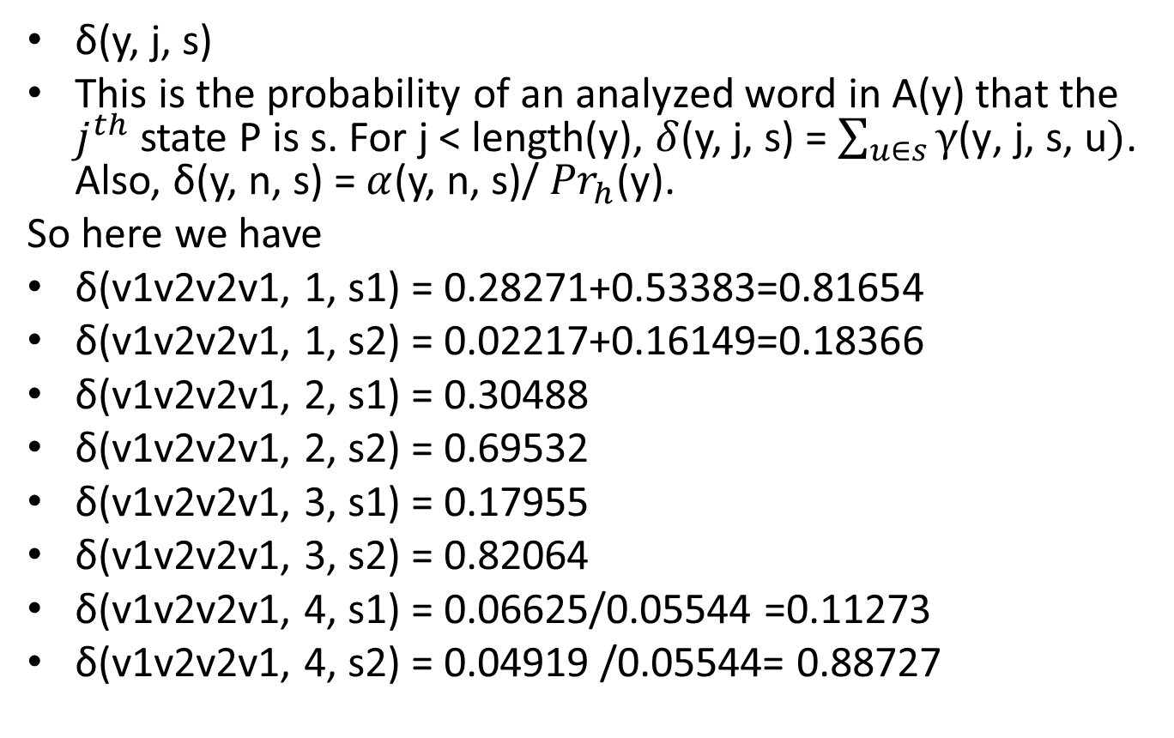
δ(y, j, s)
This is the probability of an analyzed word in A(y) that the $j^{th}$ state P is s. For j < length(y), $δ$(y, j, s) = $\sum_{u∈s}{γ\text{(}\text{y}\text{, }\text{j}\text{, }\text{s}\text{, }\text{u})}$. Also, δ(y, n, s) = $α$(y, n, s)/ ${Pr}_{h}$(y).
So here we have
δ(v1v2v2v1, 1, s1) = 0.28271+0.53383=0.81654
δ(v1v2v2v1, 1, s2) = 0.02217+0.16149=0.18366
δ(v1v2v2v1, 2, s1) = 0.30488
δ(v1v2v2v1, 2, s2) = 0.69532
δ(v1v2v2v1, 3, s1) = 0.17955
δ(v1v2v2v1, 3, s2) = 0.82064
δ(v1v2v2v1, 4, s1) = 0.06625/0.05544 =0.11273
δ(v1v2v2v1, 4, s2) = 0.04919 /0.05544= 0.88727

Slide 12
Our next HMM h2
We want to use the values along with the corpus to get a new HMM, defined by relative frequency estimates of the expected analyzed corpus c.
The starting probability of state s is I/(I + J), and that of t is J/(I + J), where
I = δ(v1v2v2v1, 1, s1) = (0.81654)=0.81654
J = δ(v1v2v2v1, 1, s2) = (0.18366) = 0.18366
So we get that the starting probability of s1 is 0.81491, and the starting probability of s2 is 0.183293.

Slide 13
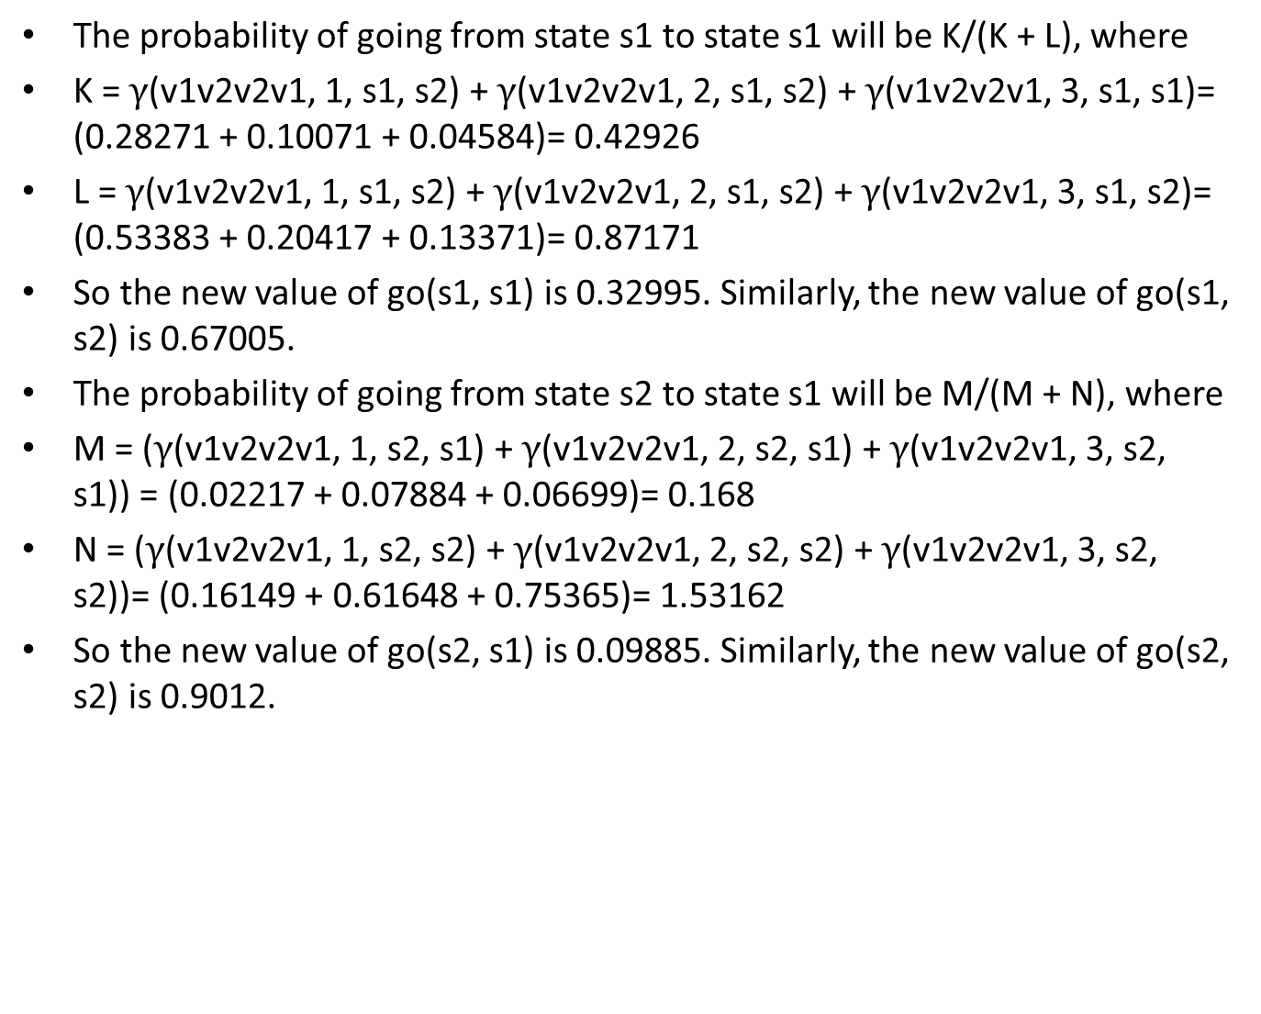
The probability of going from state s1 to state s1 will be K/(K + L), where
K = $γ$(v1v2v2v1, 1, s1, s2) + $γ$(v1v2v2v1, 2, s1, s2) + $γ$(v1v2v2v1, 3, s1, s1)= (0.28271 + 0.10071 + 0.04584)= 0.42926
L = $γ$(v1v2v2v1, 1, s1, s2) + $γ$(v1v2v2v1, 2, s1, s2) + $γ$(v1v2v2v1, 3, s1, s2)= (0.53383 + 0.20417 + 0.13371)= 0.87171
So the new value of go(s1, s1) is 0.32995. Similarly, the new value of go(s1, s2) is 0.67005.
The probability of going from state s2 to state s1 will be M/(M + N), where
M = ($γ$(v1v2v2v1, 1, s2, s1) + $γ$(v1v2v2v1, 2, s2, s1) + $γ$(v1v2v2v1, 3, s2, s1)) = (0.02217 + 0.07884 + 0.06699)= 0.168
N = ($γ$(v1v2v2v1, 1, s2, s2) + $γ$(v1v2v2v1, 2, s2, s2) + $γ$(v1v2v2v1, 3, s2, s2))= (0.16149 + 0.61648 + 0.75365)= 1.53162
So the new value of go(s2, s1) is 0.09885. Similarly, the new value of go(s2, s2) is 0.9012.

Slide 14
Updated Transition Table
 | S1 | s2
s1 | 0.339 | 0.6701
s2 | 0.09885 | 0.9012

Slide 15
Turning to the outputs, the probability that in state s1 we output v1 is K/(K + L), where
K = δ(v1v2v2v1, 1, s1) + δ(v1v2v2v1, 4, s1))= (0.81654 + 0.11273)=0.92927
L = δ(v1v2v2v1, 2, s1) + δ(v1v2v2v1, 3, s1)=(0.30488 + 0.17955)= 0.48443
Thus the probability is 0.6573. Similarly, the probability that we output v2 in state s1 is 0.342668.
The probability that in state s2 we output v1 is M/(M + N), where
M = δ(v1v2v2v1, 1, s2) + δ(v1v2v2v1, 4, s2) = (0.18366 + 0.88727)
= 1.07093
N = (δ(v1v2v2v1, 2, s2) + δ(v1v2v2v1, 3, s2))= (0.69532 + 0.82064)
= 3.503900
Thus the probability is 0.4139. Similarly, the probability that we output v2 in state s2 is N/(M + N), 0.58602.

Slide 16
Updated emission Table
 | v1 | v2
s1 | 0.6573 | 0.34267
s2 | 0.414 | 0.58602

Slide 17
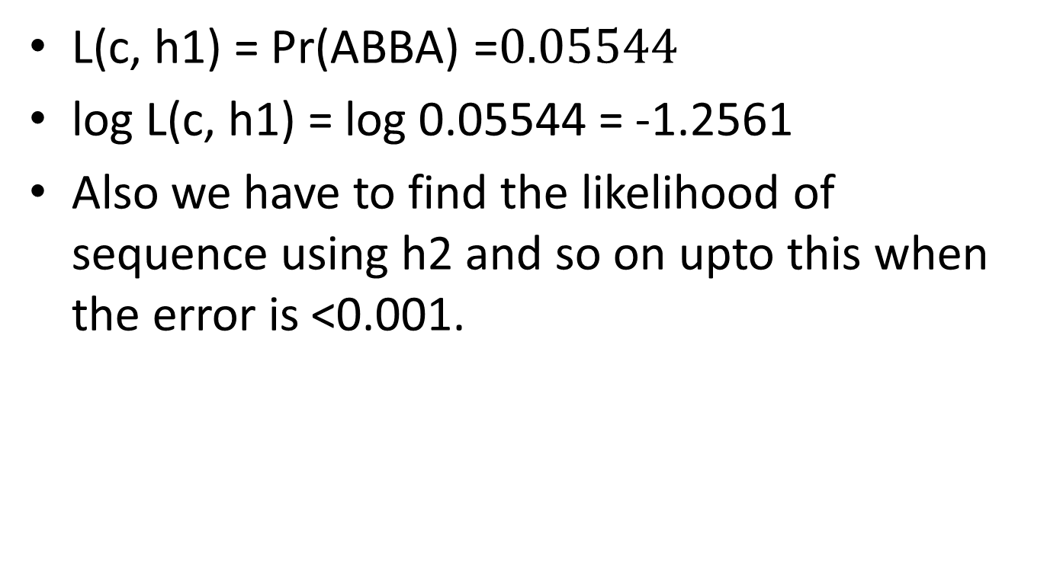
Find the log likelihood of the sequence using h1
L(c, h1) = ${\text{Pr}\text{(}\text{ABBA}\text{)}}^{ }$=${0.05544}^{}$
log L(c, h1) = log 0.05544 = -1.2561
Also we have to find the likelihood of sequence using h2 and so on upto this when the error is <0.001.

Slide 18
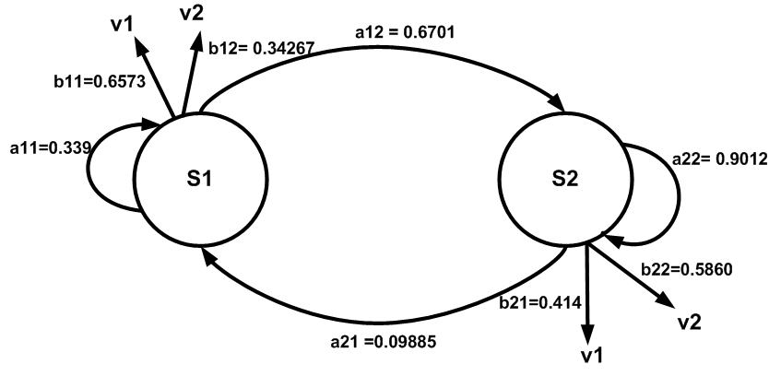
New Hmm model after first iteration

